Slide 1
Artificial Intelligence in the Financial Industry
2025
Kylie Fan

Slide 2
CONTENTS
01
02
03
AI Applications in the Financial Industry
Financial Data Processing & Analysis
Financial Data Processing & Analysis
04
05
AI Modeling Basics for Finance
AI Modeling Basics for Finance

Slide 3
Financial Data Processing & Analysis
03
Advanced Financial Analysis & Visualization

Slide 4



Calculate Metrics for Financial Insights

Slide 5
Metric | Formula/Logic
Daily Returns | (Price_t - Price_t-1)/Price_t-1
Cumulative Return | =(1 + Return_t) * (1 + Return_t-1) ...
Volatility (Rolling) | 30-day rolling standard deviation of returns
Sharpe Ratio | Average Return / Std Dev of Return
Max Drawdown | Max drop from peak in portfolio value

Slide 6

Visual Financial Analysis in Excel

Slide 7
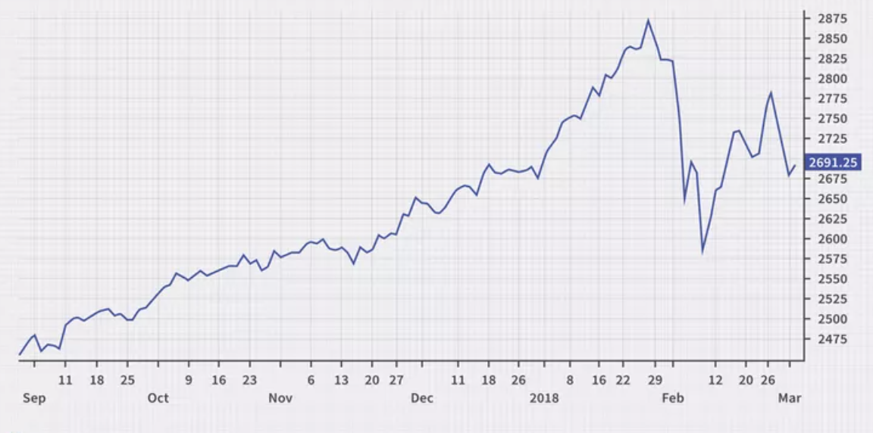
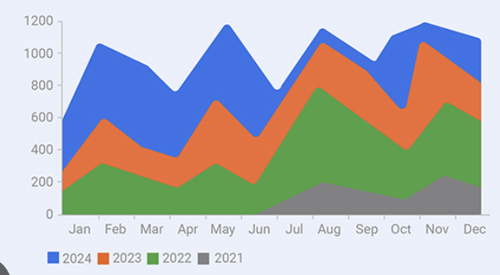
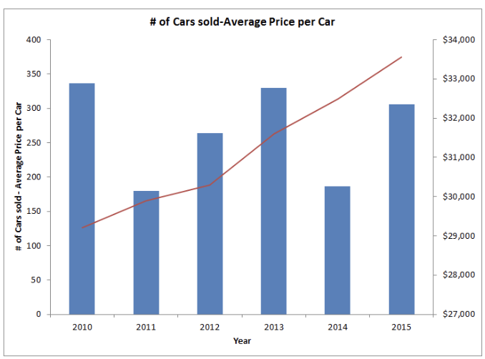
Charts for Time-Series & Comparison:
Line charts (stock prices, moving averages)
Area charts (cumulative returns)
Combo charts (return + macro indicators)

Slide 8
2. Conditional Formatting
Highlight large losses or high volatility
Use color scales to identify trends or risk

Slide 9
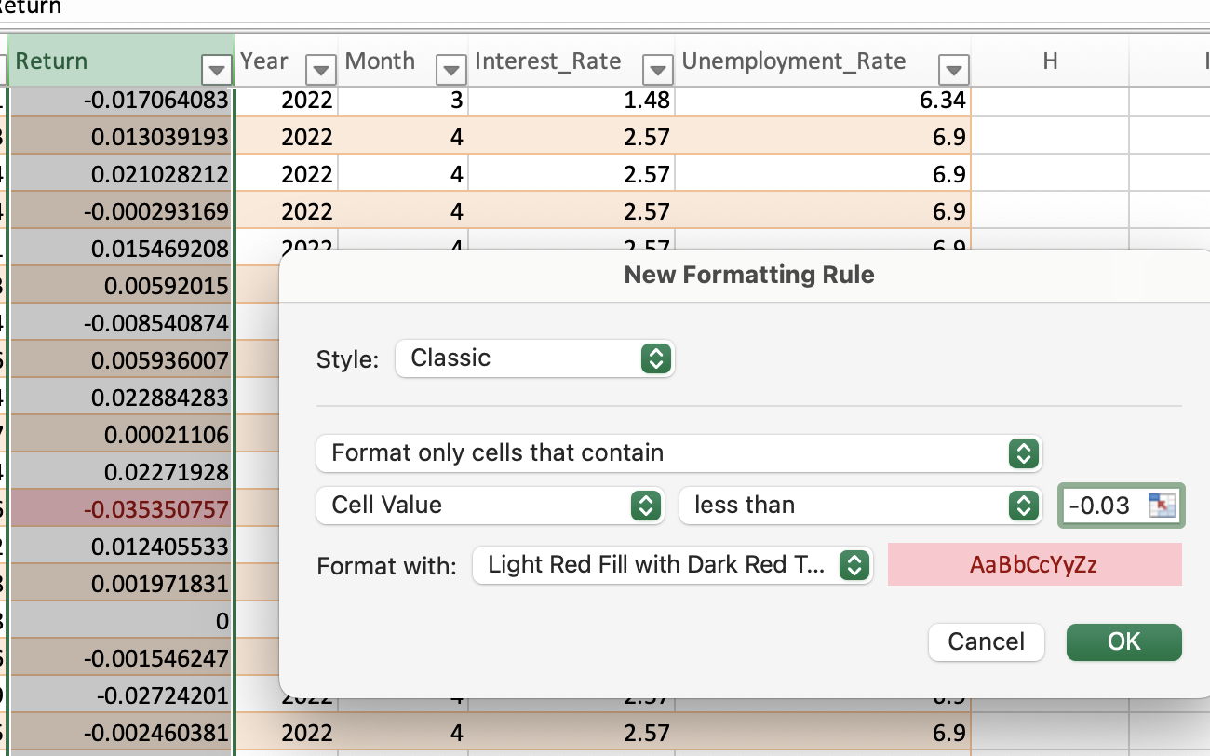
2. Conditional Formatting
Highlight large losses or high volatility
Select your Return column
Go to Home - Conditional Formatting - New Rule

Slide 10
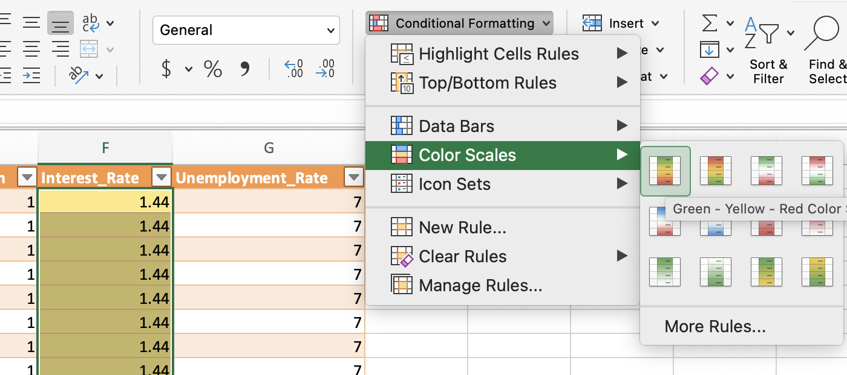
2. Conditional Formatting
Use Color Scales for Trends
Select your Interest_Rate column
Go to Home - Conditional Formatting - Color Scales

Slide 11
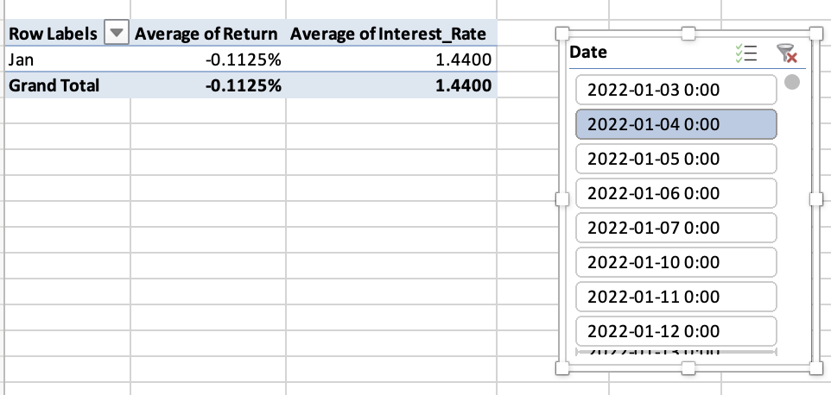
3. Slices & Timelines
Filter by date, stock ticker, or sector

Slide 12
4. Dynamic Dashboards
Use PivotTables, slicers, and names ranges
Integrate KPIs with Excel formulas + visuals

Slide 13
Power Query Advanced Use Cases
Automatically refresh data from an external source
Create custom columns for financial ratios (P/E, ROA)
Unpivot data for time-series analysis
Aggregate data (monthly returns from daily data)

Slide 14
Power Query Advanced Use Cases
Automatically refresh data from an external source:
When you:
Rename columns
Remove rows
Filter out nulls
Change data types (e.g., text → number)
Multiply values (e.g., convert 0.8 → 80)
✅ These changes are saved and applied when you click “Close & Load.”

Slide 15
THANKS FOR WATCHING
2025

